Slide 1
Measurement
Topic: Volume and Capacity
EQ: How do we work out the capacity of prisms?
Mrs Stretch
Year 9

Slide 2

24 - 7 - 30
For each lesson done so far, go back and:
Highlight the important sections
Write a summary

Slide 3
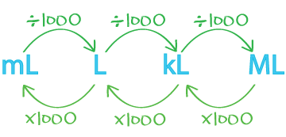
24
7
30
Volume and Capacity
Date
EQ – How do we work out the capacity of prisms?
What is Capacity?
Capacity is a measure of how much a container can hold
Usually refers to liquids
Common units are:

Slide 4
24
7
30
Volume and Capacity
Date
EQ – How do we work out the capacity of prisms?
What is Capacity?
To calculate the capacity of a container we use the same formulas for measuring volume.
Then we convert the units for volume to capacity units

Slide 5
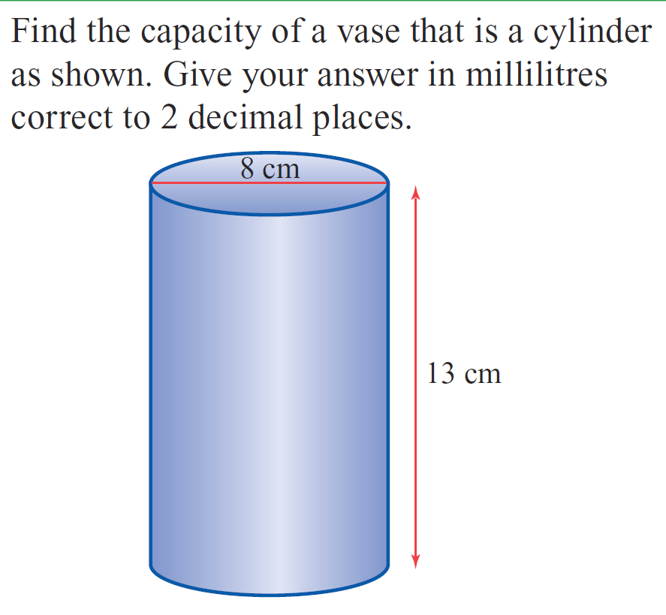
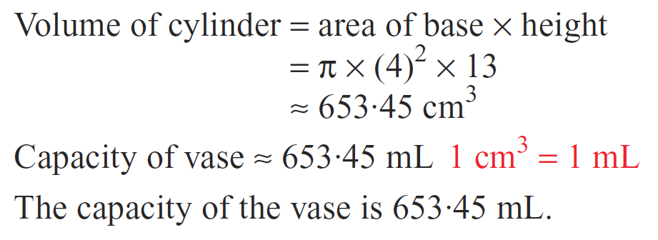
Practice

Slide 6


Slide 7
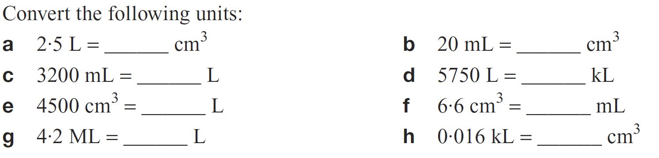
Task

Slide 8
